Slide 1


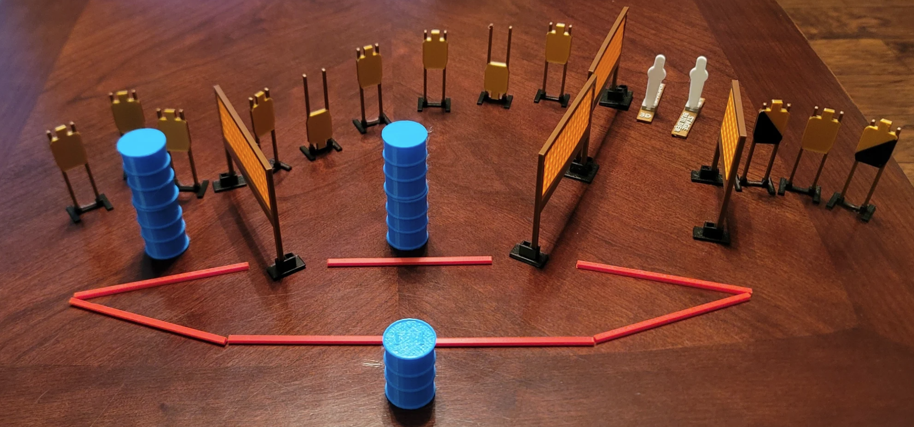
 | Dothan Gun Club – USPSA Match Hosing Course Designer : Eric Henwood Bay:
Round Count 26 rounds 12 USPSA 2 colt poppers
Equipment List 9 wall feet (probably need an extra wall in the middle) Use colts for the poppers

Slide 2
Hosing
Written Stage Briefing
Scoring: Comstock Rounds: 26
Targets: 12 USPSA, 2 steel
Handgun start position: anywhere inside the shooting area, wrists below belt. Handgun is loaded and holstered.
PCC start position: anywhere inside the shooting area, stock on belt. Loaded carbine is held with both hands, safety on.
Stage Procedure: on audible start signal, engage targets as they become available from within the shooting area.

